Slide 1
Tornados : A Force of Nature
Project Group 6

Slide 2
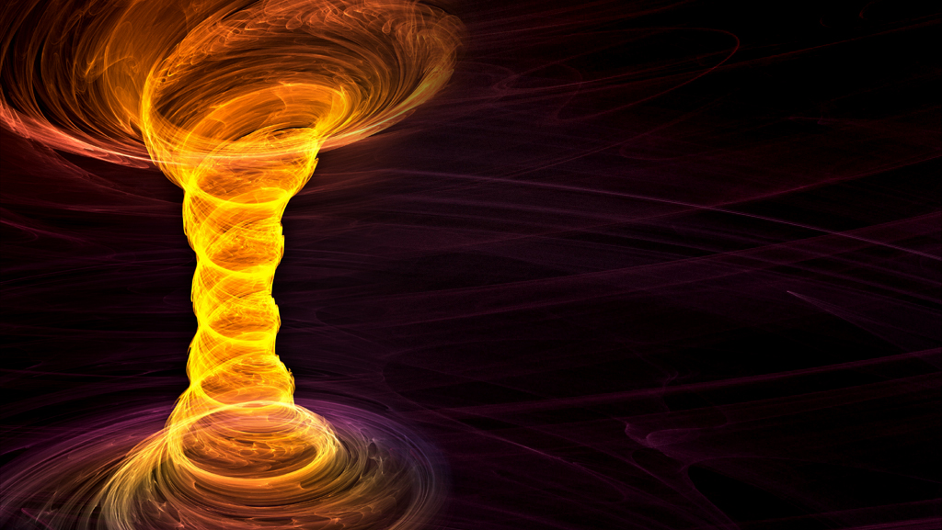
Group Members
Richard Malolepsy
Gavin Wan
Priya Maringanti
Shankar Mohanathas

Slide 3
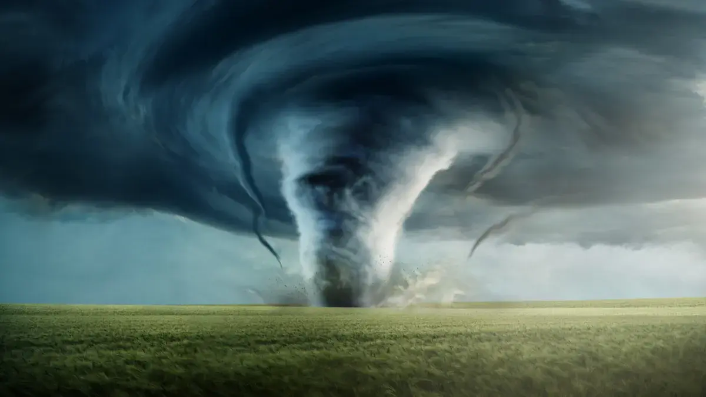
What is a Tornado?
A violently rotating column of air touching the ground
Found usually at the base of a thunderstorm

Slide 4
Tornados in the USA
Our Pitch!

Slide 5
Thought Process

Slide 6
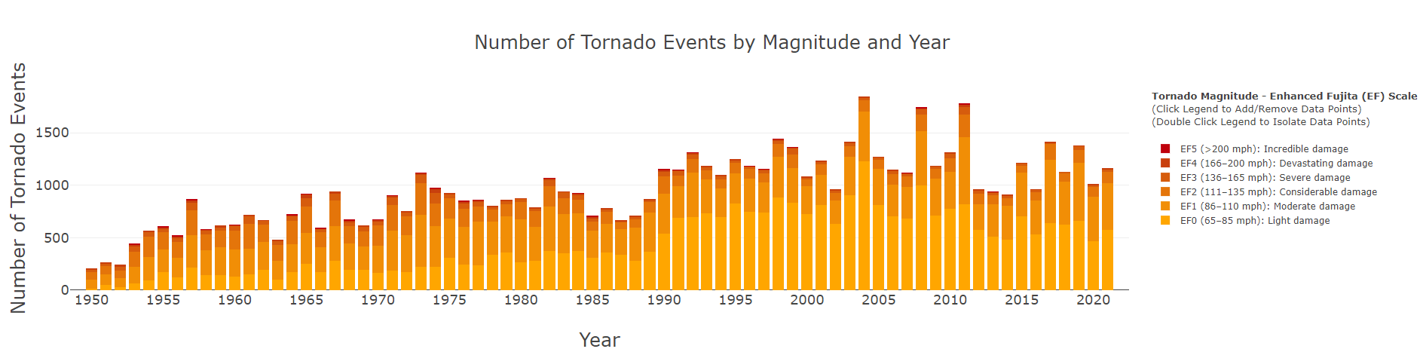
The Enhanced Fujita Scale

Slide 7
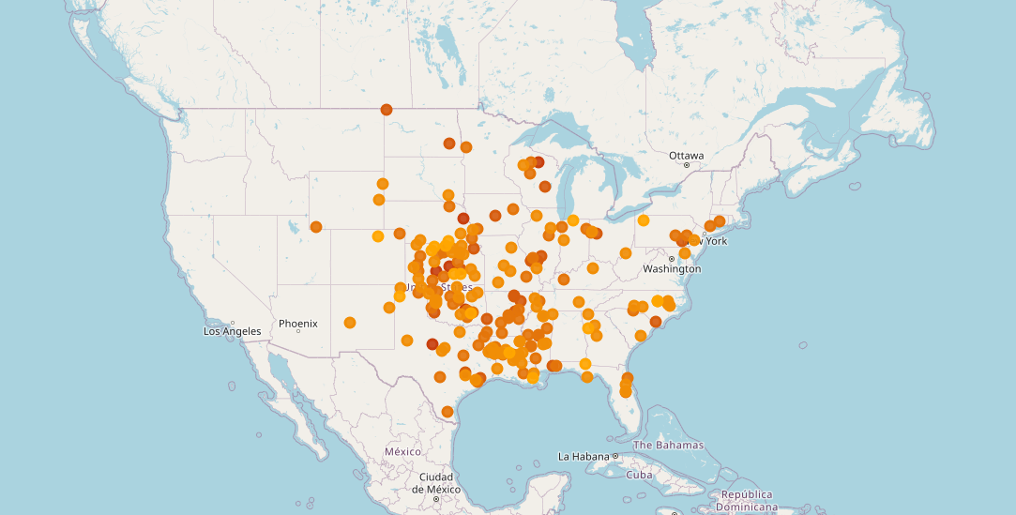
Tornados Map of the USA

Slide 8
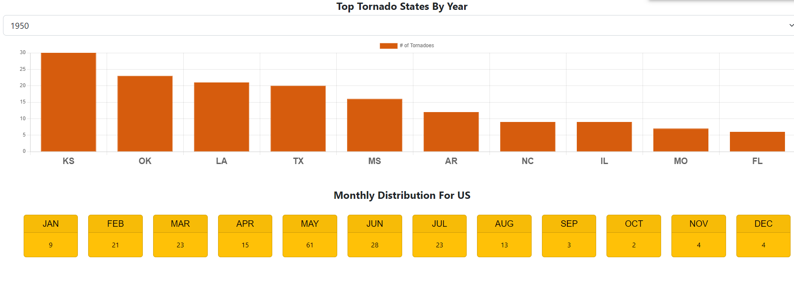
Charting Distributions of States and Months

Slide 9

Limitations
Knowledge
Approach
Information availability

Slide 10
Conclusions and Connections
Average Person
Planning a Vacation
Buying a house
Big Picture
Business Planning
Public Safety and Emergency Response
Urban Planning

Slide 11
QUESTIONS?

